Slide 1
Module 6 Guidance Notes Characters and Strings in C
COMP2113 Programming Technologies
ENGG1340 Computer Programming II

Slide 2
What are we going to learn?
C program compilation
A simple program in C
C basic standard I/O
printf
scanf
Character functions
isdigit
tolower
atoi
…
String functions
strcpy
strcmp
…
You are about to write your first program in C (not C++)

Slide 3
Compiling a C Program
You have tried using C-strings in a C++ program (in Module 6.2). Here, we will start writing C programs and play with C-strings and its I/O in C. In order to do this, we will be using the C compiler (C11 version).
We may still compile and execute a C program using the Atom editor with gcc-make-run program, just make sure that:
Your source program file has a name with an extension .c, e.g., program1.c
In the Atom editor, in “Preferences” -> “Packages” -> “Gcc Make Run” -> “Settings” and under “Compiler Flags”, put down “-pedantic-errors -std=c11” instead (see next page).
For command line compilation, use:
gcc -pedantic-errors -std=c11 your_program.c –o your_program
You can then use “./your_program” to execute the program.

Slide 4
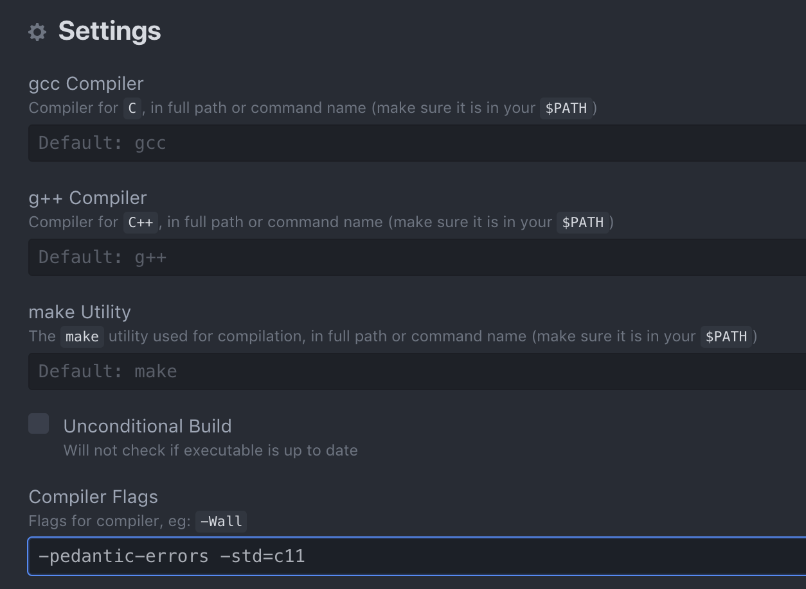
Compilation in C

Slide 5
Hello World in C
Take a look at this simple program in C.
/* this is my first C hello world program */
#include <stdio.h>
int main() {
printf("Hello World!\n");
return 0;
}
helloworld.c
Compare this to the C++ program
// this is my first C++ hello world program
#include <iostream>
using namespace std;
int main() {
cout << “Hello World!” << endl;
return 0;
}

Slide 6
Hello World in C
/* this is my first C hello world program */
#include <stdio.h>
int main() {
printf("Hello World!\n");
return 0;
}
Comments are enclosed in
/* … */
Comments may span multiple lines
Include stdio.h for using standard I/O functions such as printf
Standard output are done via the printf statement
The newline character '\n' is used for the line break.
Try compile the program and check the result.

Slide 7
Adding Two Numbers
addition.c
Standard input is done via the scanf function. "%d" is the format control string which indicates that the input data should be in integer.
&x is the memory location of the variable (x) in which the data should be stored.
This statement essentially reads in an integer and store it to the variable x.
#include <stdio.h>
int main()
{
int x, y, z;
printf("Enter first integer:\n");
scanf("%d", &x);
printf("Enter second integer:\n");
scanf("%d", &y);
z = x + y;
printf("Sum is %d\n", z);
return 0;
}
Screen output
Enter first integer:
32
Enter second integer:
65
Sum is 97
The numbers in blue above are user inputs.
We will talk more about formatted input and output in C in later modules.

Slide 8
Character Handling Functions in C
We discussed character handling functions in C++ earlier (here).
In C, we have the corresponding library of functions under the <ctype.h> header for character handling.
int isdigit(int c) | Returns a nonzero (true) value if c is a digit, and 0 (false) otherwise
int isalpha(int c) | Returns a nonzero (true) value if c is a letter, and 0 (false) otherwise
int isalnum(int c) | Returns a nonzero (true) value if c is a digit or a letter, and 0 (false) otherwise
int islower(int c) | Returns a nonzero (true) value if c is a lowercase letter, and 0 (false) otherwise
int isupper(int c) | Returns a nonzero (true) value if c is an uppercase letter, and 0 (false) otherwise
int tolower(int c) | If c is a lowercase letter, returns c as an uppercase letter. Otherwise, returns the argument unchanged.
int toupper(int c) | If c is an uppercase letter, returns c as lowercase letter. Otherwise, returns the argument unchanged.
You can see that they are just the same except that you will need to include a different header file in your program.
Reference only: check this for more character handling functions

Slide 9
First of all, note the include headers here for C.
Let’s rewrite the program on this slide in C. The program output should be the same.
"%c%s%s\n" is the format tag which indicates that printf will output a character (%c) followed by two strings (%s), and finally a newline char to the standard output.
#include <stdio.h>
#include <ctype.h>
int main()
{
char a;
a = '7';
printf("%c%s%s\n", a, isdigit(a) ? " is " : " is not ", "a digit" );
a = '$';
printf("%c%s%s\n", a, isdigit(a) ? " is " : " is not ", "a digit" );
a = 'B';
printf("%c%s%s\n", a, isalpha(a) ? " is " : " is not ", "a letter" );
a = 'b';
printf("%c%s%s\n", a, isalpha(a) ? " is " : " is not ", "a letter" );
a = '4';
printf("%c%s%s\n", a, isalpha(a) ? " is " : " is not ", "a letter" );
a = 'Z';
printf("%c%s%s\n", a, islower(a) ? " is " : " is not ", "a lowercase letter" );
a = 'z';
printf("%c%s%s\n", a, isalpha(a) ? " is " : " is not ", "a lowercase letter" );
a = '5';
printf("%c%s%s\n", a, isalpha(a) ? " is " : " is not ", "a lowercase letter" );
a = 'M';
printf("%c%s%s\n", a, islower(a) ? " is " : " is not ", "an uppercase letter" );
a = 'm';
printf("%c%s%s\n", a, isalpha(a) ? " is " : " is not ", "an uppercase letter" );
a = '#';
printf("%c%s%s\n", a, isalpha(a) ? " is " : " is not ", "an uppercase letter" );
return 0;
}
The first character to output is the value stored in variable a (corresponding to "%c" in the format tag)
The last string to output is "a digit”. This corresponds to the second "%s" in the format tag
The next string to output depends on the value of isdigit(a), if it is true, then " is " is output; otherwise " is not " is output. This corresponds to the first "%s" in the format tag
charfunc.c

Slide 10
Character Handling Functions in C
charconvert.c
This is another example to show the conversion between uppercase and lowercase for characters using functions in <ctype.h>
#include <stdio.h>
#include <ctype.h>
int main()
{
char a;
a = 'e';
printf("%c converted to uppercase is %c\n", a, toupper(a));
a = 'S';
printf("%c converted to uppercase is %c\n", a, toupper(a));
a = '%';
printf("%c converted to uppercase is %c\n", a, toupper(a));
a = '9';
printf("%c converted to uppercase is %c\n", a, toupper(a));
a = 'w';
printf("%c converted to lowercase is %c\n", a, tolower(a));
a = 'R';
printf("%c converted to lowercase is %c\n", a, tolower(a));
a = '&';
printf("%c converted to lowercase is %c\n", a, tolower(a));
a = '2';
printf("%c converted to lowercase is %c\n", a, tolower(a));
return 0;
}
Screen output
e converted to uppercase is E
S converted to uppercase is S
% converted to uppercase is %
9 converted to uppercase is 9
w converted to lowercase is w
R converted to lowercase is r
& converted to lowercase is &
2 converted to lowercase is 2

Slide 11
Strings in C
Recall the internal representation of string which is an array of char (C-Strings), ended by a null character ('\0’):
You will have to deal with C-Strings directly in C.
"Hello World!"
A character array of 13 elements
A string of length = 12
'H' | 'e' | 'l' | 'l' | 'o' | ' ' | 'W' | 'o' | 'r' | 'l' | 'd' | '!' | '\0'
the space character
the null character to indicate the end of string
Each element is of type char

Slide 12
String Conversion Functions
You may manipulate individual characters in a char array storing a string, or you may make use of some string handling functions.
Let's take a look at some string conversion functions first. These functions convert the numbers stored as a string to int or double.
Include <stdlib.h> for using the following functions
int atoi(const char *str) | Converts the string pointed to by str to int
double atof(const char *str) | Converts the string pointed to by str to double
the "const" specifier indicates that the parameter str (i.e., the string input to these functions) will not be modified by the functions
the "*" here means a pointer to the input string (i.e. an address of the memory location where the string is stored). For the time being, just remember that the name of the character array storing the string provides such a pointer and therefore can be passed to these functions as arguments). See example usage on the next page.
Reference only: check this for more string handling functions

Slide 13
String Conversion Functions
stringconvert.c
#include <stdio.h>
#include <stdlib.h>
int main()
{
int i;
double d;
long l;
i = atoi("1340");
printf("The string \"1340\" converted to int is %d\n", i);
printf("The converted value minus 111 is %d\n", i-111);
d = atof("23.9");
printf("The string \"23.9\" converted to double is %.3f\n", d);
printf("The converted value divided by 3 is %.3f\n", d / 3);
return 0;
}
the "%.3f" specifier indicates that printf is to output a floating point number (f) with 3 decimal places (.3)
Screen output
The string "1340" converted to int is 1340
The converted value minus 111 is 1229
The string "23.9" converted to double is 23.900
The converted value divided by 3 is 7.967

Slide 14
String Handling Functions
These string handling functions are commonly in used in C.
Include <string.h> for using the following functions
char *strcpy(char *s1, const char *s2) | Copies the string s2 into the array s1
char *strncpy(char * s1, const char *s2, size_t n) | Copies n characters of the string s2 into the array s1
char *strcat(char *s1, const char *s2) | Appends the string s2 into array s1. The first character of s2 overwrites the terminating '\0' character of s1
char *strncat(char *s1, const char *s2, size_t n) | Appends n characters of the string s2 into array s1. The first character of s2 overwrites the terminating '\0' character of s1
int strcmp(const char *s1, const char *s2) | Compares the string s1 to the string s2. Returns 0, less than 0, or great than 0 if s1 is equal to, less than, or greater than s2, in lexicographical order, respectively
size_t strlen(const char *s) | Returns the length of string s (i.e., the number of characters preceding '\0')
Note that C-strings do not support direct assignment, e.g., you CANNOT write char s1[20];
s1 = "abc";
so you need strcpy() to do assignment
Also, comparison of strings using == is not supported, you'll need to use strcmp() for C-strings comparison
This is the same as the unsigned integer type, i.e., the number must be a non-negative number

Slide 15
String Handling Functions
#include <stdio.h>
#include <string.h>
int main()
{
char x[30] = "ENGG1340 computer programming";
char y[30], z[10];
char s1[20] = "Keep calm ";
char s2[20] = "and code ";
char s3[40] = "";
strcpy(y, x);
printf("%s\n%s\n", x, y);
strncpy(z, x, 8);
printf("%s\n%s\n", z, y);
printf("%s\n", s1);
strcat(s1, s2);
printf("%s\n", s1);
strncat(s3, s2, 4);
printf("%s\n", s3);
strcat(s3, s1);
printf("%s\n\n", s3);
printf("%d\n", strcmp(x, y));
printf("%d\n", strcmp(s1, s3));
printf("%d\n\n", strcmp(s1, x));
printf("length of x = %d\n", strlen(x));
return 0;
}
Note that you'll need to make sure that the destination char array for the copy functions is large enough for the resulting string; otherwise, runtime error will occur
Screen output
ENGG1340 computer programming
ENGG1340 computer programming
ENGG1340
ENGG1340 computer programming
Keep calm
Keep calm and code
and
and Keep calm and code
0
-22
6
29
string_manipulation.c

Slide 16
Using C-Strings in C++
Sometimes you may need to deal with C-Strings in C++, and the character and string handling functions for C-Strings are made available to C++ too:
in C | in C++
#include <ctype.h> | #include <cctype>
#include <stdlib.h> | #include <cstdlib>
#include <string.h> | #include <cstring>
To convert a C++ string to C-string, you may use the .c_str() member function of a string object:
#include <string>
#include <cstring>
int main()
{
string str = "abc";
char s1[10];
strcpy(s1, str.c_str());
cout << s1 << endl;
return 0;
}
A C++ program
Question: How to convert a C-String to C++ string then?
Hint: check this slide

Slide 17
Programming Exercises in C
Try solve a few programming problems in Module 6.3 in C.

